Slide 1
Investing In Toronto
Ashwani Wadhwa

Slide 2
Business Problem
Audience
Real-estate Investment firms
Investor groups and Individual Investors
Objective
Provide insight to invest or live in for people looking for locations where a good quality of life is combined with a good numbers of amenities around
Goal
Obtain a single score that will be used to classify the different neighborhood and that our customer can use to prioritize different areas where to acquire properties and offices

Slide 3
Data
Wikipedia
List of Toronto neighborhoods and postal codes
ARCGIS
Latitude and longitudes for every postal code
Foursquare
Venue Information
WalkScore
Indexes of Walking, Public Transport and Bike riding availability
GitHub
Toronto GeoJSON file of the neighborhood boundaries visualization

Slide 4
Methodology
Compile the geographical information for every neighborhood
Collet information about venues from the Foursquare API
Get information about walking easiness on every neighborhood, from walkscore
Capture public transport information through WalkScore API
Generate global quality score based on analyzed parameter

Slide 5
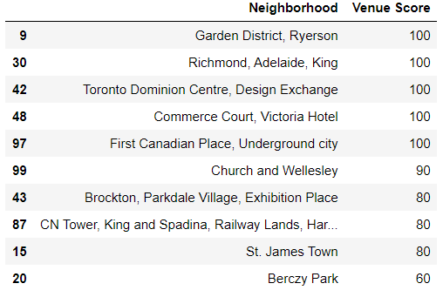
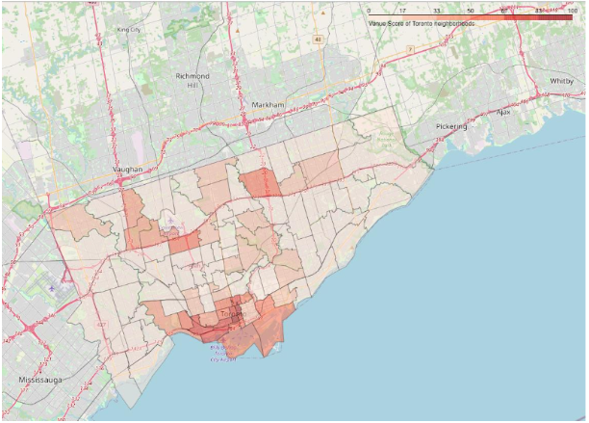
Result I: Venues

Slide 6
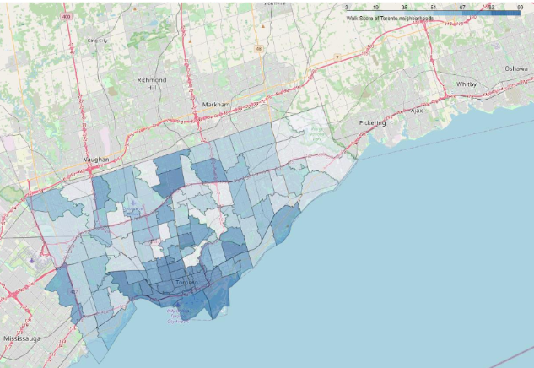
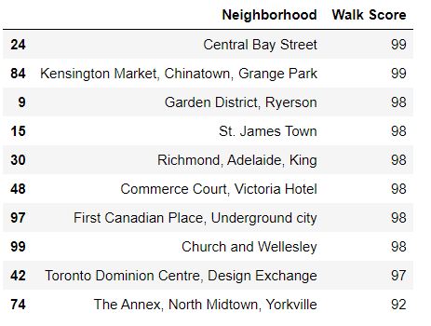
Result II: Walking

Slide 7
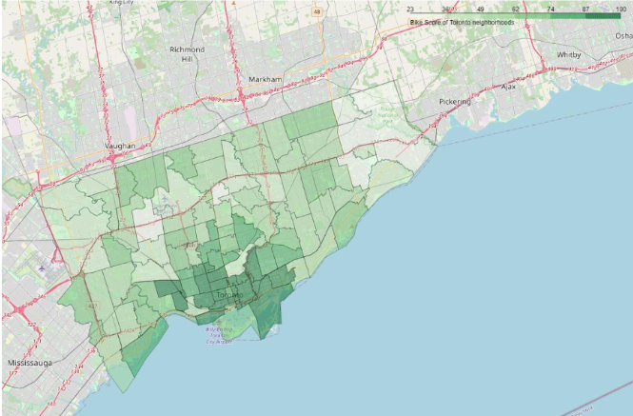
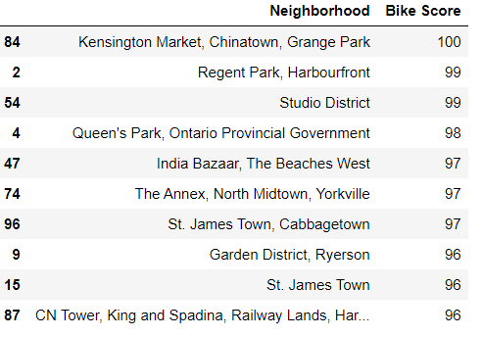
Result III: Bike

Slide 8
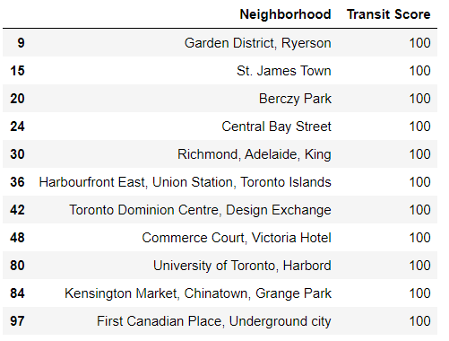
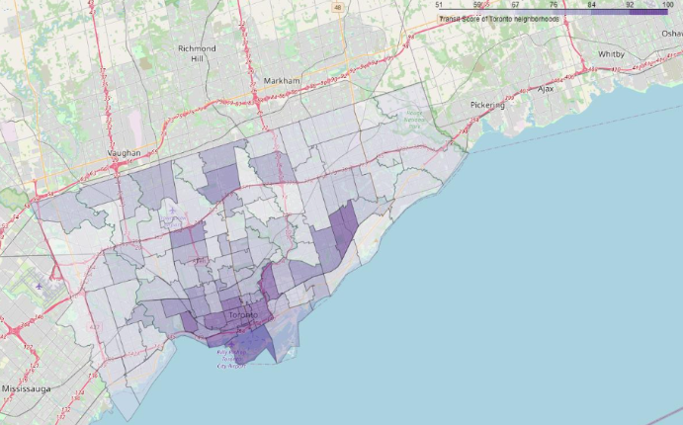
Result IV: Public Transport

Slide 9
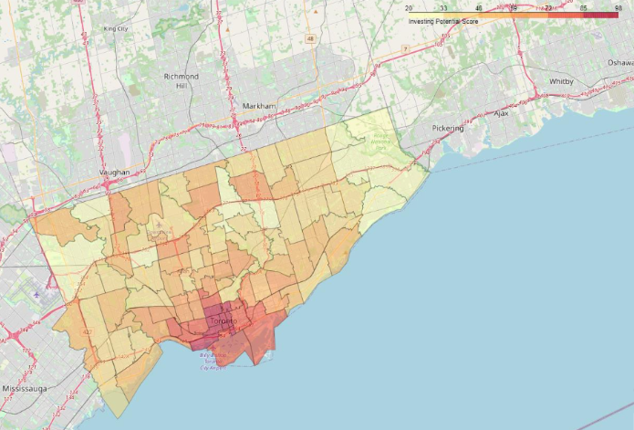
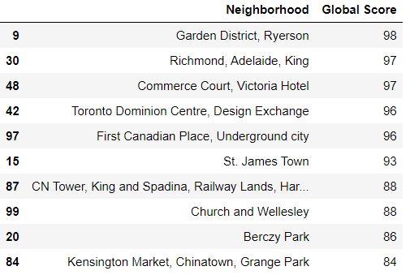
Result V: Global Score

Slide 10
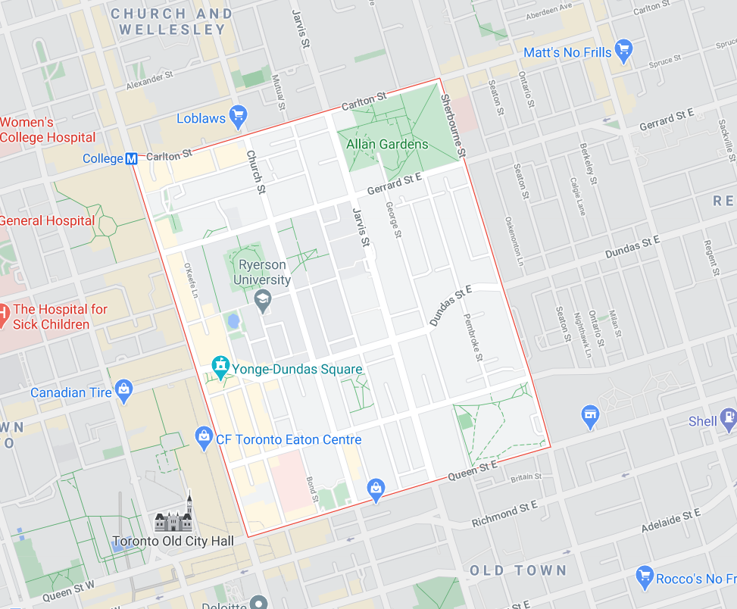
Conclusion
Garden District – Ryerson
This is the only neighborhood that appears on every top-10 classification.

